Slide 1

TUKL DEEP LEARNING LAB NUST
STATISTICAL DATA AUGMENTATION 2.0
MUHAMMAD AHMED MOHSIN
ADVISOR: SIR . ADNAN UL HASSAN

Slide 2

PREVIOUS WORK
-Increased the efficiency of TabAug research paper by 6-7% through additional data set and changing the internal structure of the neural network.
We trained the TabAug model on ICDAR 2013 data set and UNLV data sets.
By changing the hyperparameters we were also able to increase the accuracy for our model.

Slide 3

Change of course
Due to semester project, we changed our course to TabNet. TabNet used object detection to detect tables and their structures.
TabNet was trained on MARMOT dataset.
We applied image segmentation instead of object detection and then applied advanced image processing algorithms on both data sets as well as the resulting masks from the models.
The datasets used were Marmot and ICDAR 2013

Slide 4
Changes we made
Increased the efficiency of already proposed TabNet by enhancing the architecture of the encoder and adapting a suitable series of dataset processing to the Extended Marmot dataset.
Deduced that an image processing pipeline, while reducing generalization, can transform unseen images into a form factor similar to the original dataset, thereby increasing the evaluative metrics.
Proposed advanced image filtering pipelines to increase OCR capabilities of Tesseract.
Implemented a third encoder specific to Rows, as proposed in the concluding remarks of the original paper

Slide 5
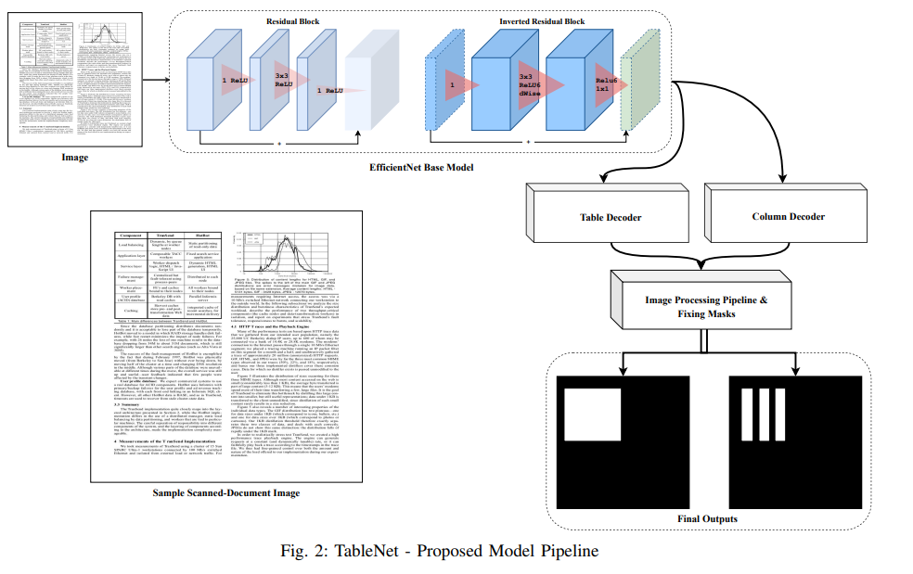

Slide 6
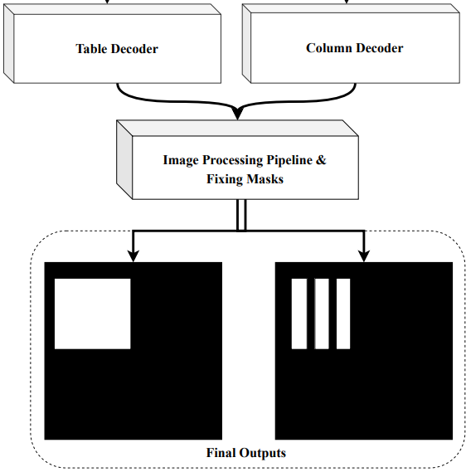
PIPELINE
Detection
Fix Masks
Erosion
Dilation
Contours
Image Upscaling
Text Extraction
Pytesseract OCR

Slide 7
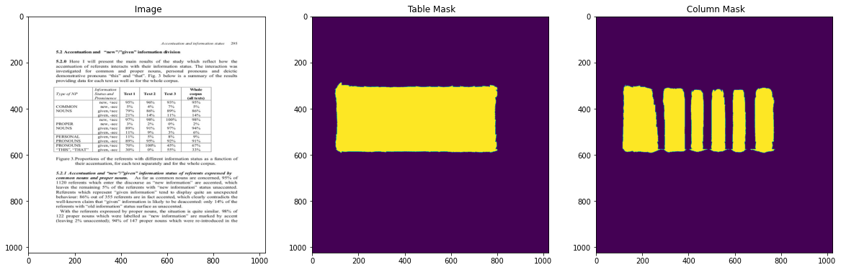

Slide 8
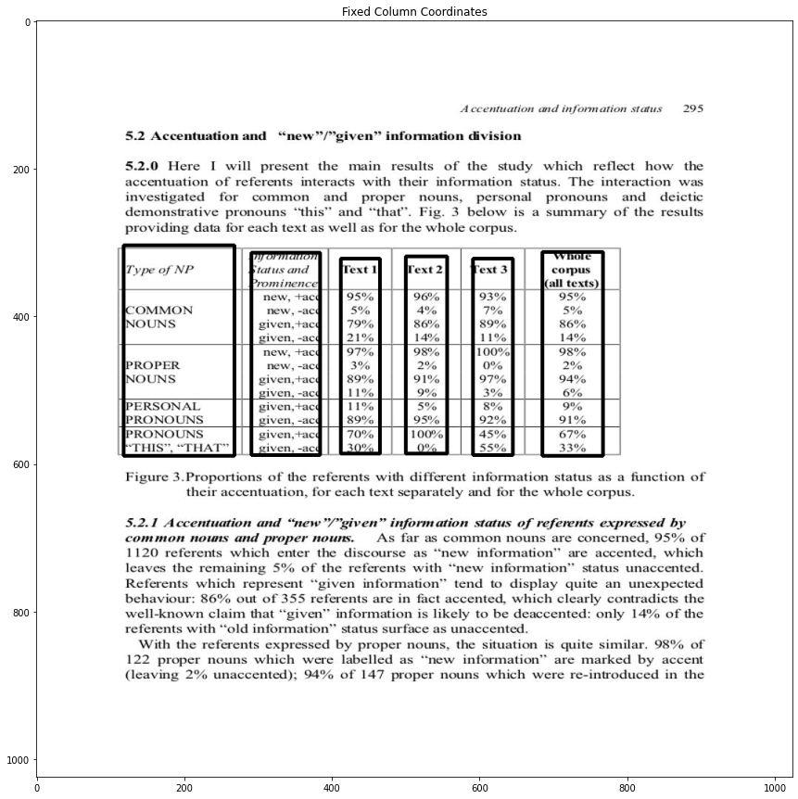
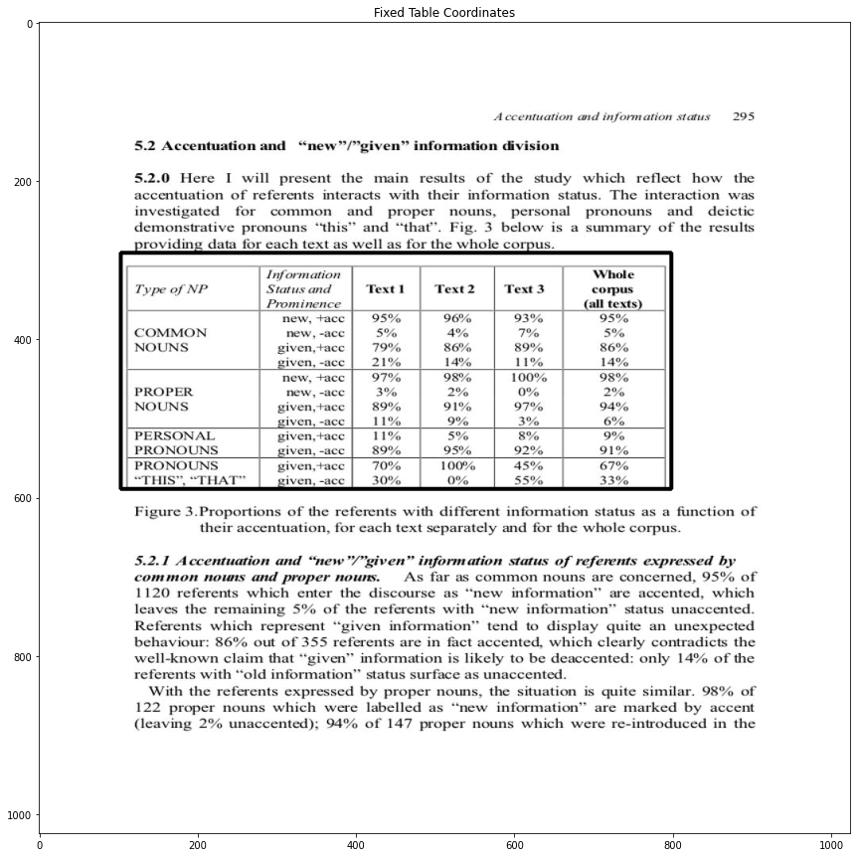

Slide 9
Future Goals
Manually annotating MARMOT dataset for catering row detection.
Implementing new/ upcoming advanced image processing filters in our proposed architecture
Making detection on lossless .pdf files

